Slide 1


Hospital System
Name: Ali Al Hadi Ayache
Course Name: Web Development
Dr.Name: Mohammad El Hajj
Date:Jun-09-2022

Slide 2

CONTENTS
INTRODUCTION……………………………………………………….3
PROBLEM………………………………………………………………4
SOLUTION……………………………………………………………...5
PHASE-1…………...…………………………………………………....6
PHASE-2………………………………………………………………...7
PHASE-3………………………………………………………………...8
LIMITATIONS…………………………………………………………11
CONCLUSION…………………………………………………………12
FUTUREWORK………………………………………………………..13

Slide 3

INTRODUCTION
Objectives:
Help patient to book an appointment for a doctor from house.
Help patient to find a private nurse.
Help patient to find a donator blood or any organ.
Help university students to find a training to give them an experiences.

Slide 4

PROBLEM
Book / Cancel an appointment not easy from Hospital.
Patients don’t know all doctors.
Not easy to find an blood in same type or organ, private nurse.
University students always need to find an training.
Taking a room in hospital need time.

Slide 5

SOLUTION
Easy to Book / Cancel an appointment from house in any time.
Patients know all information the you need of doctors.
Blood and Organ bank are available.
University students always can import profile to making training.
In any time you can take a room in hospital.

Slide 6

PHASE 1
We used html to create static web pages from index to last page.(forms,..).
We used css designs all website.(navbar,font,color,…).
We used css flexbox layout module. (Divide into containers).
Most pages that contains html and css are the plogs in website.
HTML-CSS

Slide 7

PHASE 2
Construct an application program interface for number of patient covid-19 by using ajax jQuery.
Alert when open website to wear a mask in hospital.
Eye for login (Password). {Added Later(new)}.
Date not available for old days (Yesterday). {Added Later(new)}.
JavaScript - JQuery

Slide 8

PHASE 3-1
Construct a query (insert,delete,select) to build system.
Used phpmyadmin to build tables for data.(Database).
Building login interface for { Admin , Doctor , Patients}.
PHP-MYSQL

Slide 9
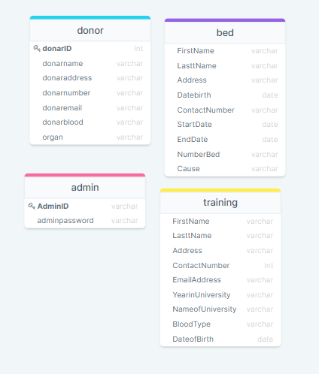
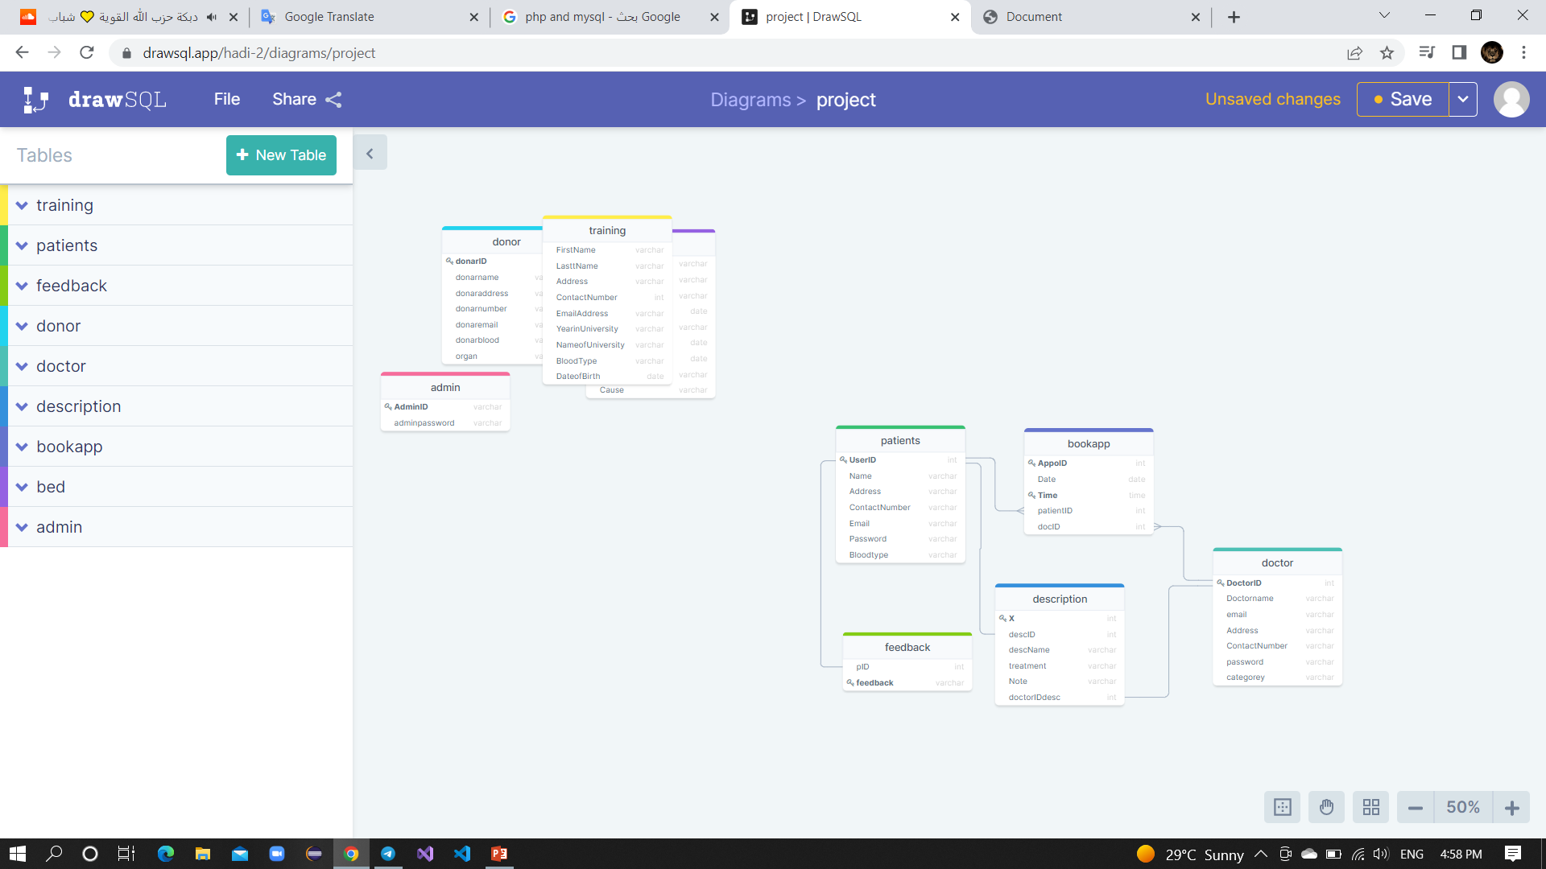
PHASE 3-2
PHP-MYSQL

Slide 10

PHASE 3-3
Insert Query used in booking room , appointment ,new doctor ,donate organ , training student, add description, signup.
Delete Query used in booking appointment to cancel it.
Select Query used to display all information about booking room , appointment , doctors,pateints ,organs , training student.
PHP-MYSQL

Slide 11
LIMITATIONS
In pharmacy services and medicines we need an application program interface this are paid.
This system are very huge and need huge time for every phase in it.
This system everyday are developed.

Slide 12

CONCLUSION
This system can be available for any hospital.
Any one can used it easy.
Don’t need time to take an appointment.
Easy to find nurse and blood or organ.

Slide 13

FUTURE WORK
We can add price management for every thing example (Visa card).
We can add lab to present result for patients.
We can add radiology , Pharmacy.

Slide 14

THANK YOU!

